Slide 1

Unveiling the Dynamic of US Stock Indexes
with PU Prime
Live Market Insights
Webinar Series

Slide 2



The Proficient Trader | PU Prime
Highlights
01
What is US Stock Indexes
02
Advantages versus Disadvantages of US Stock Index
03
Factors that affecting US Stock Indexes
04
Calculation (Profit & Losses, Margin Requirement

Slide 3

What is
US Stock Indices?

Slide 4

The Proficient Trader | PU Prime
What is US Stock Index?
1
Definition: A dynamic reflection of market performances
2
Purpose: A compass guiding investors through the vast landscape of stocks
3
Navigating the Stock Index Spectrum
S & P 500 (Broad Market Indexes)
Nasdaq (Tech-heavy Indexes)
Dow Jones (Price-weighted Indexes)

Slide 5
US Stock Index
Different US Stock Indexes, serves as a gauge for different aspects of the U.S. stock market. The Dow focuses on a select group of large, established companies, NASDAQ emphasizes technology and growth-oriented firms, while the S&P 500 provides a broader representation of the overall U.S. market.
Dow Jones
Nasdaq
S&P 500
Time-tested index since 1896
Birthed by Charles Dow’s vision
Price-weighted for a unique perspective
Key companies included:
Apple, Microsoft, Boeing
Born in 1971
Haven for growth-oriented Companies
Tech-heavy Indexes
Market Cap-weighted methodology
Key companies included: Amazon, Google and Tesla
Heartbeat of 500 large-cap US companies
Diverse tapestry spanning various sectors
Invest in S&P 500 similar with invest in all companies in the US region

Slide 6

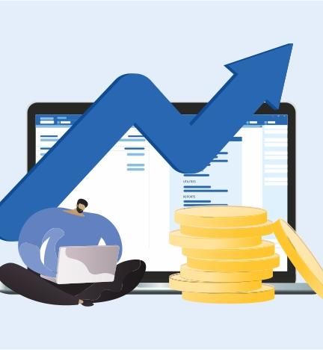

Broad Market Exposure: Riding the waves of overall market trends
Diversification: Your shield against market turbulence
Low Cost & Time Saving
Advantages

Slide 7



Market Volatility: Embracing the dance of highs and lows
Limited Potential for Outperformance
Difficulties
Disadvantages

Slide 8
US Treasury Yields & Interest Rate Decisions versus Equity Performances
Borrowing Costs &
Economic Stimulus
Discounting
Future Cash Flows
Substitutions with
Fixed-income & Forex
Explanation: Low-interest rates set by central banks reduce the cost of borrowing for businesses and individuals, encouraging investment and spending.
Impact on Stock Indexes: Low rates stimulate economic growth, leading to increased corporate profits and higher stock prices in indexes like the S&P 500.
Explanation: Low interest rates result in a lower discount rate for future earnings, making projected cash flows more valuable in today's terms.
Impact on Stock Indexes: Lower discount rates contribute to higher stock valuations, especially benefiting sectors sensitive to interest rates, such as technology and growth stocks.
Explanation: Low interest rates make currencies & fixed-income instrument less attractive, potentially shifting investor preferences toward the stocks
Impact on Stock Indexes: Low interest rates may lead to demand on stocks, causing increment in stock prices and indexes.

Slide 9

The Proficient Trader | PU Prime
Federal Reserve
Rate Hikes Expectations (July)
0 / - 25 bps ?
Current rate hike bets on 31st January Fed interest rate decision:
Source: CME Fedwatch Tool
0 bps (98%) VS -25 bps (2%)

Slide 10

The Proficient Trader | PU Prime
Others Factor (P/E ratio, Profit Growth)
1
P/E ratio
2
Profit Growth (financial statement performance)
3
Investors’ Confidence
4
Economic Growth

Slide 11
The Proficient Trader | PU Prime
Sector/Trending in 2024
Artificial Intelligence
Technology

Slide 12
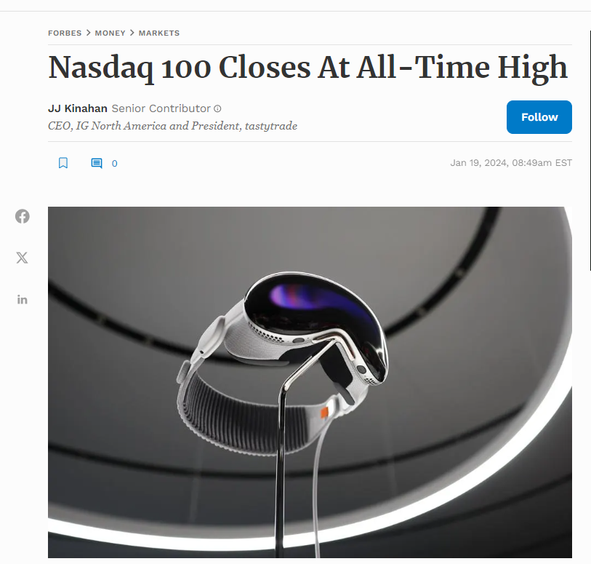
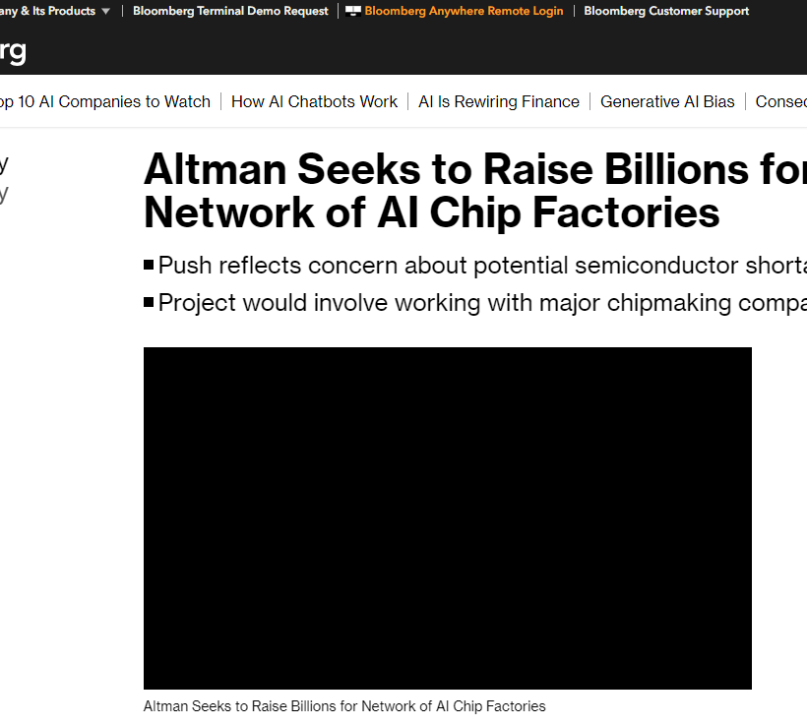
AI & Tech Heavy Indexes become hot investment

Slide 13
The Proficient Trader | PU Prime
Combining Fundamental & Technical Analysis

Slide 14
Thank You

